Slide 1

Strategies to Ensure Students Attend College and Persist
Catalina Cifuentes
Executive Director of College and Career Readiness
Riverside County Office of Education
Steve Ayon
Assessment, Accountability, and Continuous Improvement
Riverside County Office of Education

Slide 2
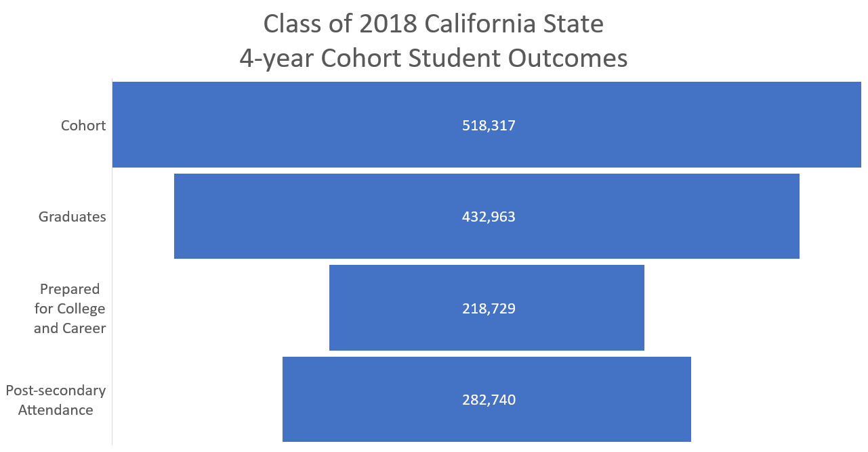

Slide 4
Riverside County, California College Going Rate
Class of 2013 Baseline College Enrollment: 15,066
Class of: | Number of Students Enrolled in fall after Graduation | Total Number of Additional Students From Baseline in 2013
2014 | 15,827 | 761
2015 | 16,300 | 1,234
2016 | 17,023 | 1,957
2017 | 17,485 | 2,419
2018 | 18,274 | 3,208
Data Source: National Student Clearinghouse

Slide 5

First Name | Last Name | District | Email
Quyen | Nguyen | Alvord USD | qnguyen@alvordschools.org
Felicia | Adkins | Banning USD | fadkins@banning.k12.ca.us
Kerri | Moreno | Beaumont USD | kmoreno@beaumontusd.k12.ca.us
Juliet | De Lara | Coachella Valley USD | jdelara@cvusd.us
Eva | Pina | Corona-Norco USD | epina@cnusd.k12.ca.us
Rosario | Martinez | Desert Sands USD | rosario.martinez@desertsands.us
Alex | Ballard | Hemet USD | aballard@hemetusd.org
Pamela | Whitman | Jurupa USD | pamela_whitman@jusd.k12.ca.us
Tammy | Williams | Lake Elsinore USD | tammy.williams@leusd.k12.ca.us
Janice | Manus | Moreno Valley USD | jmanus@mvusd.net
Glenn | Alegre | Moreno Valley USD | galegre@mvusd.net
Robert | Harte | Murrieta Valley USD | mharte@murrieta.k12.ca.us
Robert | McGonical | Murrieta Valley USD | rmcgonigal@murrieta.k12.ca.us
Rachel | McKee | Nuview | rmckee@nuview.k12.ca.us
Bonnie | Rose | Palm Springs USD | brose@psusd.us
Tim | Slagan | Palo Verde USD | tslagan@pvusd.us
Kerry | Bobbitt | Perris Union High SD | kerry.bobbitt@puhsd.org
Steve | Ayon | RCOE | sayon@rcoe.us
Brian | Sousa | RCOE | bsousa@rcoe.us
Valerie | Backstrom | Riverside USD | VBackstrom@rusd.k12.ca.us
Angela | McKinney | Riverside USD | amckinney@rusd.k12.ca.us
Jeannette | Juarez | San Jacinto Academy | jjuarez@sjacademy.org
Kim | Lovette | San Jacinto USD | klovette@sanjacinto.k12.ca.us
Cheryl | Krueger | Temecula Valley USD | ckrueger@tvusd.k12.ca.us
Jim | Earnst | Val Verde USD | jernst@valverde.edu

Slide 6
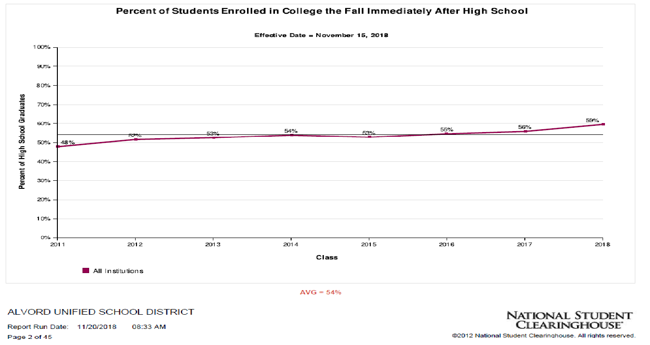

Slide 7
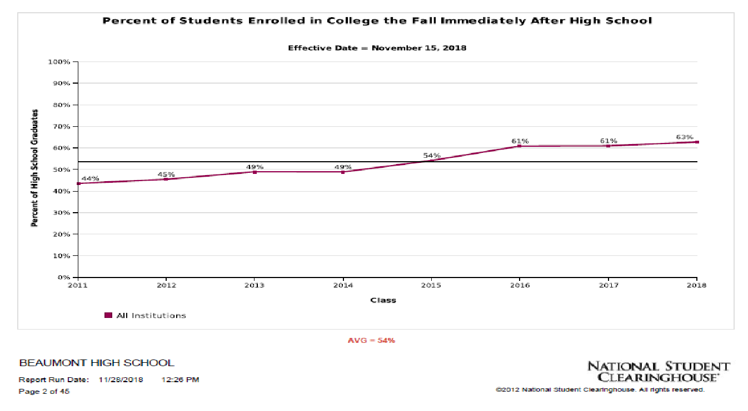

Slide 8
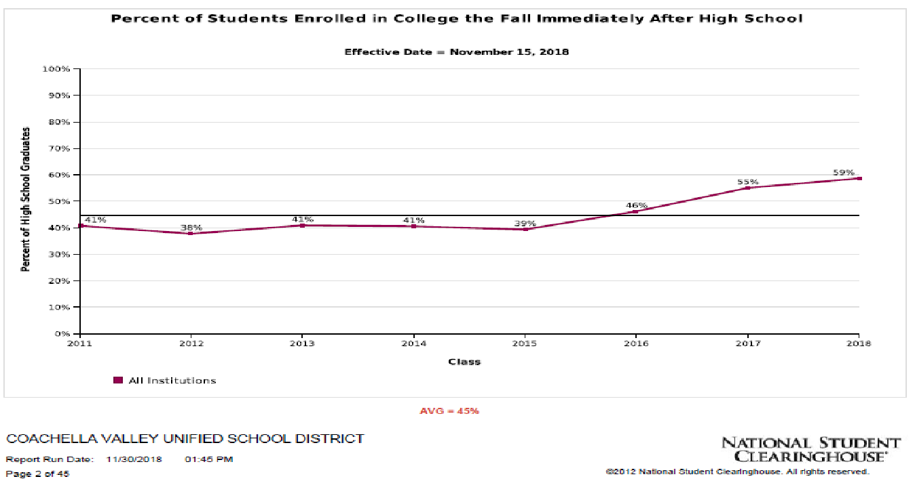

Slide 9
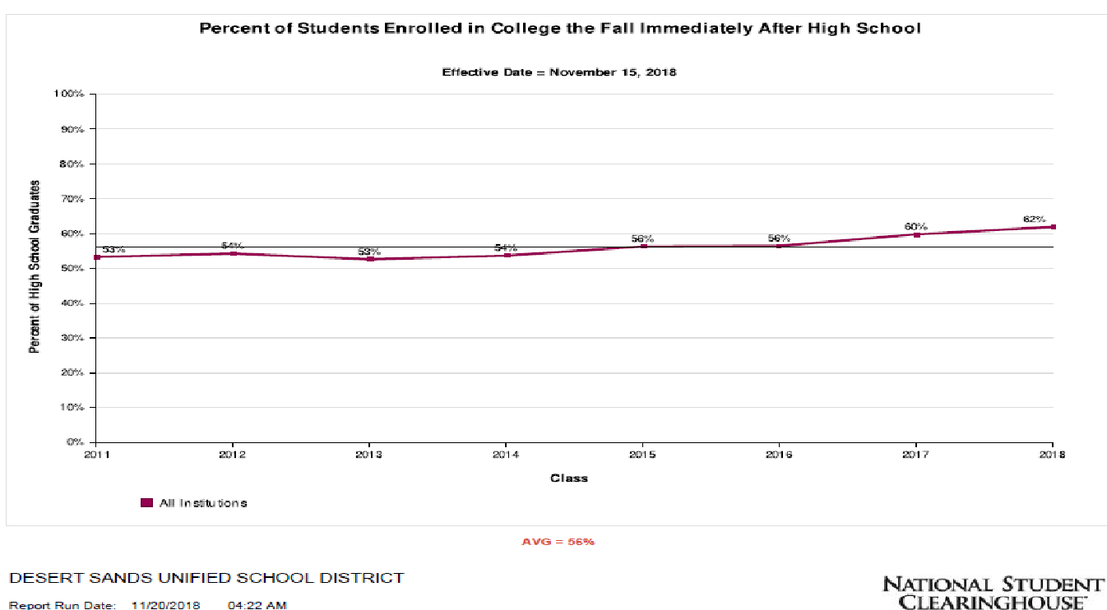

Slide 10
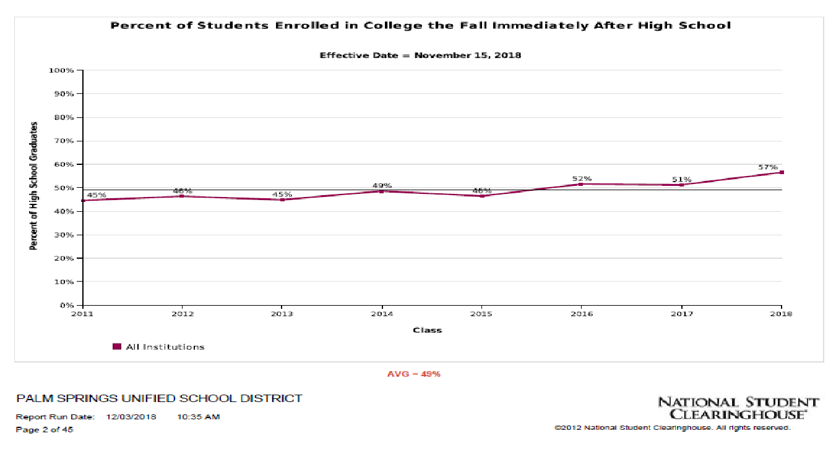

Slide 11
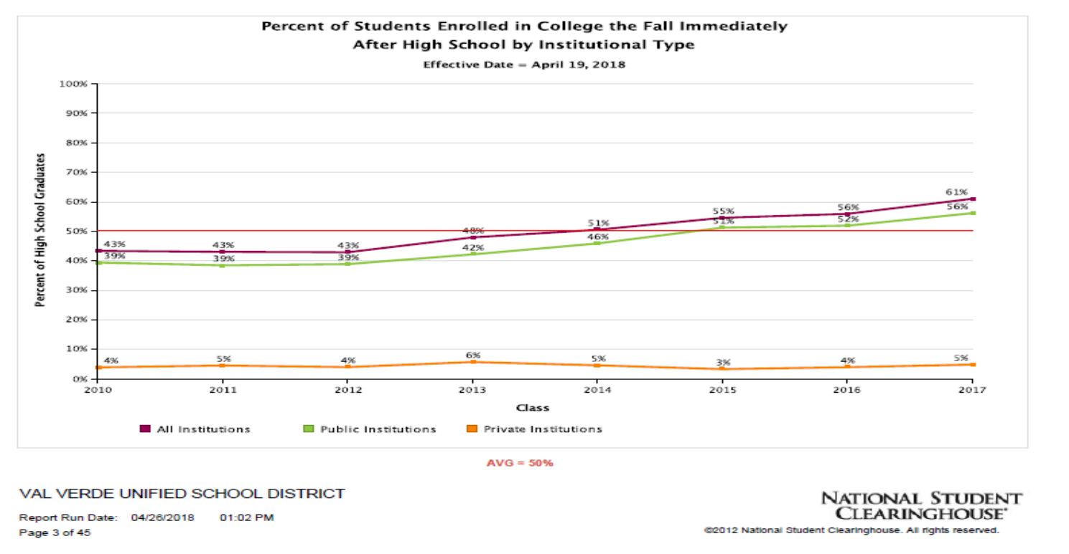

Slide 12
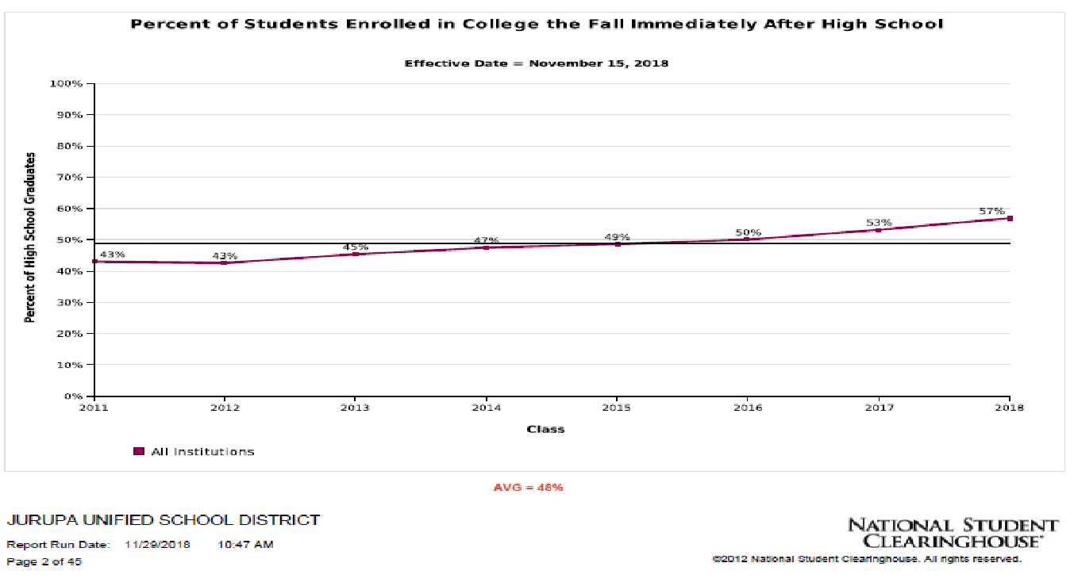

Slide 13
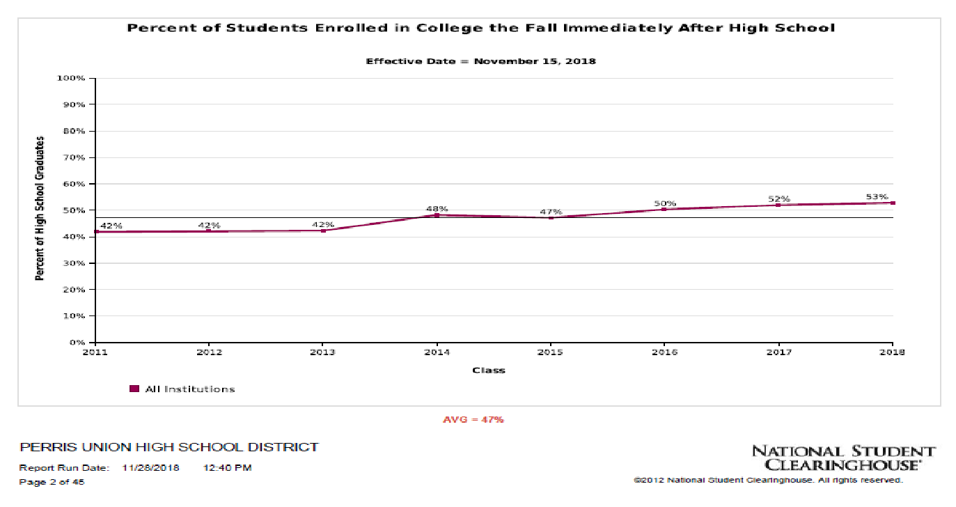

Slide 14
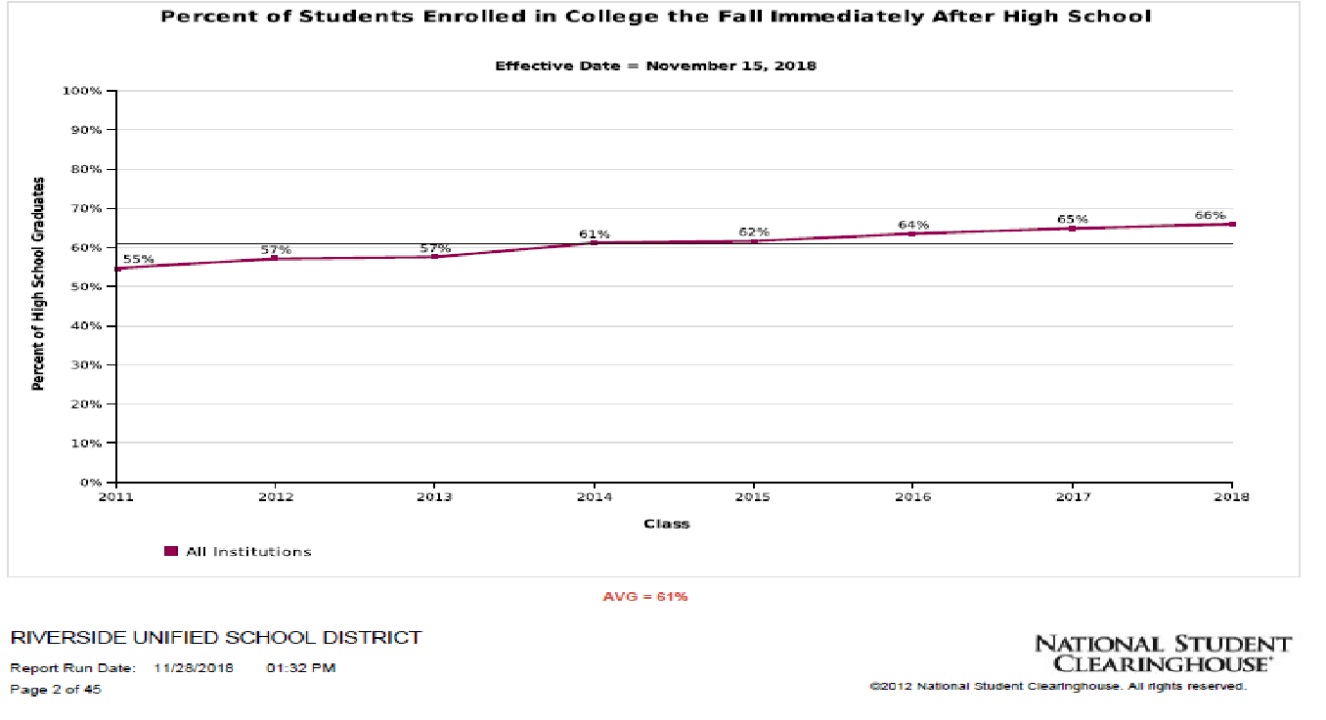

Slide 15
Riverside County Office of Education
Student Tracker for High Schools
© 2018 National Student Clearinghouse. All Rights Reserved.

Slide 16




The Clearinghouse
Mission
© 2019 National Student Clearinghouse. All Rights Reserved.
We serve the education and workforce communities and all learners with access to trusted data, related services, and insights.

Slide 17
Over 12,000
OUR REACH
Secondary school partners,
representing 55% of US 12th graders
98%
85%
Title IV degree-granting institutions representing 98% of
U.S. postsecondary education enrollments participate in the Clearinghouse
Working with every state’s K-12 or postsecondary education department in a research capacity
1.3 BILLION
data transactions managed by the Clearinghouse every year
3,600+
participating colleges
and universities (Title IV degree
granting schools)
25 MILLION
pieces of enrollment information received by the Clearinghouse every month
Enrollment Records are updated AT LEAST 4X per term or semester
6
© 2019 National Student Clearinghouse. All Rights Reserved.

Slide 18


Comprehensive Nationwide Coverage
98% 94%
Enrolled Students
Earned Degrees
4
© 2019 National Student Clearinghouse. All Rights Reserved.

Slide 19

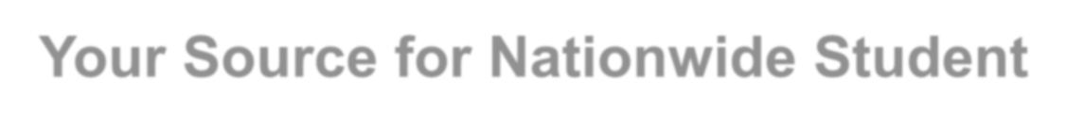

StudentTracker®
High School
Your Source for Nationwide Student Postsecondary Outcomes
© 2019 National Student Clearinghouse. All Rights Reserved.

Slide 20

What is StudentTracker for High Schools?
© 2019 National Student Clearinghouse. All Rights Reserved.
Software-as-a-service reporting platform
Bridges the high school to
college transition
Gives historical context to graduated cohorts
9

Slide 21


Your Students. Your Data.
Your Insights.
Track your student outcomes
Find insights through enrollment and degree reporting
Understand the paths your students take to achieve higher education success
Manage your programs with validated outcomes
10
© 2019 National Student Clearinghouse. All Rights Reserved.

Slide 22





How does StudentTracker for High School Work?
Submit Graduates files
Store & Match 3x per year
Produce StudentTracker reports
Return reports via secure FTP, or Access the Reports Library

Slide 23
Riverside County
National Student Clearinghouse
Student Tracker Process
Student Information System
Upload to StudentTracker
StudentTracker Reports
CALPADS
Produce Upload File

Slide 24
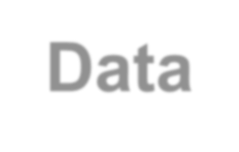

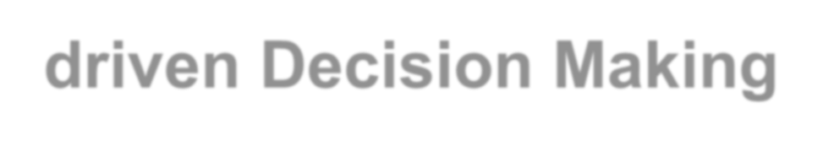


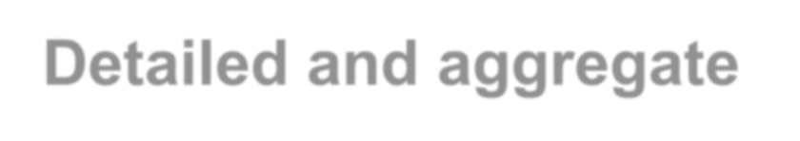

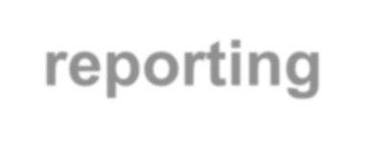



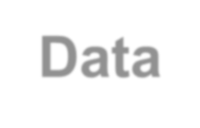


Data-driven Decision Making
Detailed and aggregate enrollment and degree reporting
Easily accessible reports
Data-informed decisions

Slide 25

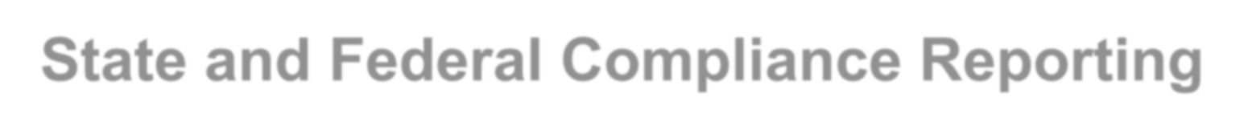

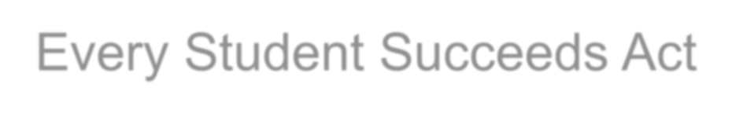

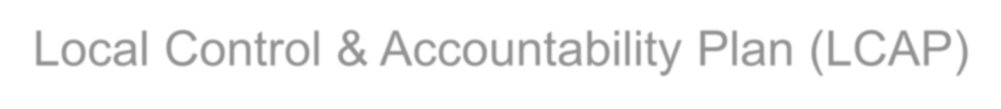
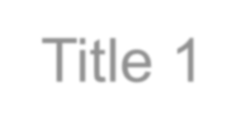

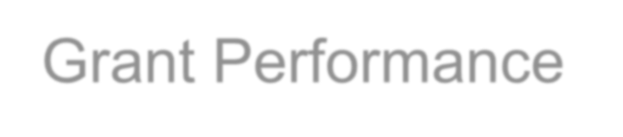

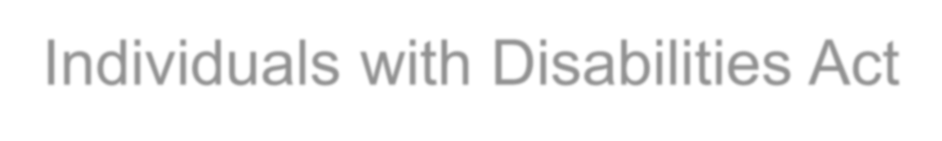
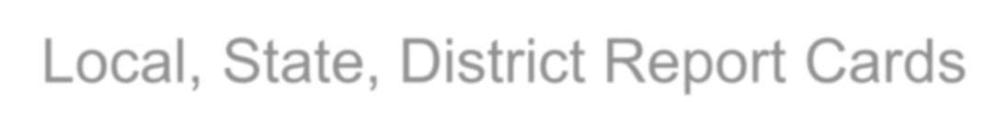
How StudentTracker for High Schools Supports State and Federal Compliance Reporting
Every Student Succeeds Act
Local Control & Accountability Plan (LCAP)
Title 1
Grant Performance
Individuals with Disabilities Act
Local, State, District Report Cards

Slide 26


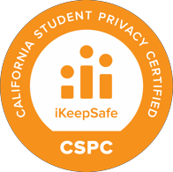


Federal Education Rights & Privacy Act (FERPA)
100% FERPA Compliant
Return only Directory Information from postsecondary institutions
StudentTracker recognizes postsecondary FERPA blocks

Slide 27
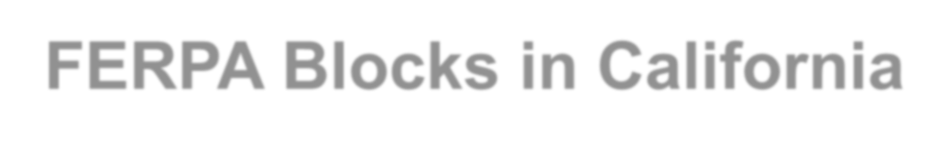

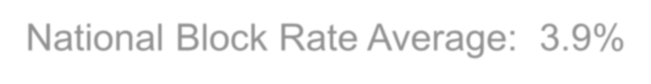
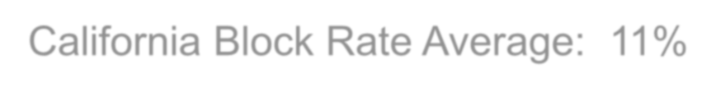
FERPA Blocks in California
What is a FERPA Block?
A student may invoke a directory information block at any institution attended, at any time, by notifying institution officials in writing. The institution will then update the directory block indicator for the student in its next scheduled
data submission to the Clearinghouse.
National Block Rate Average: 3.9% California Block Rate Average: 11%

Slide 28
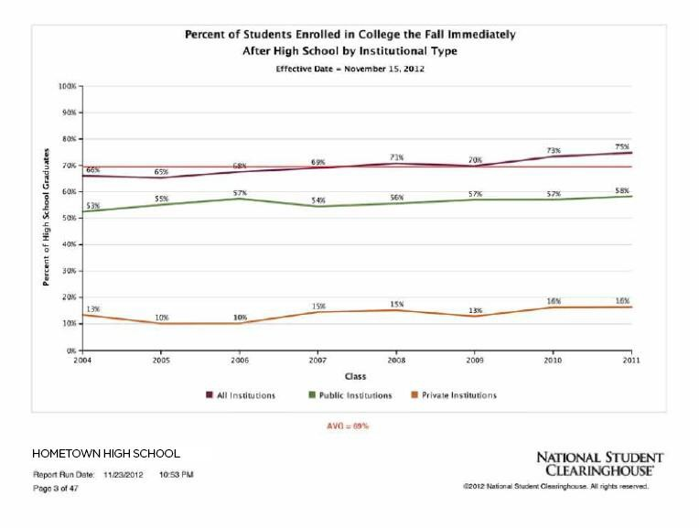
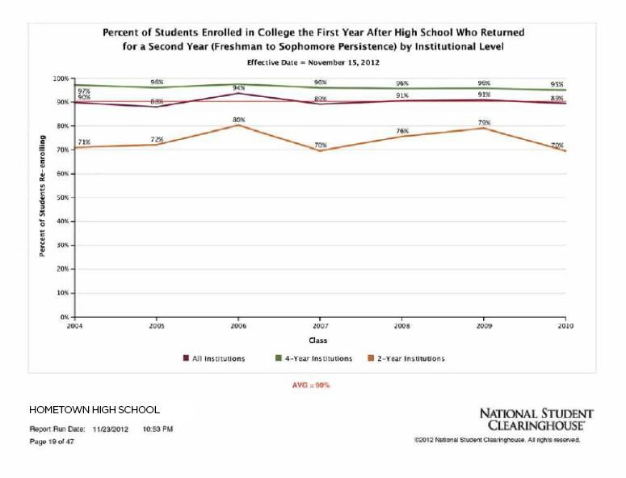
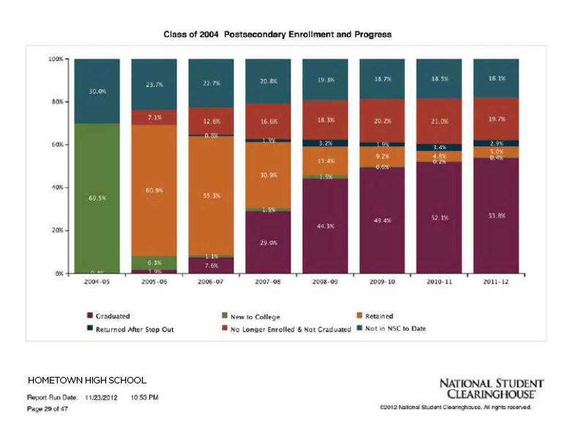
Aggregate Reports

Slide 29



8-Year Cohorts Reported
8 years of data allows you to compare your graduating classes across any number of demographic or academic measures

Slide 30

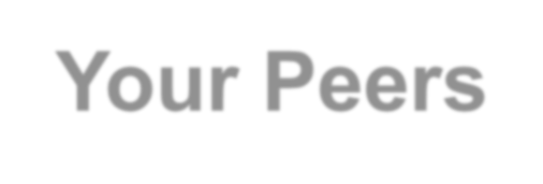


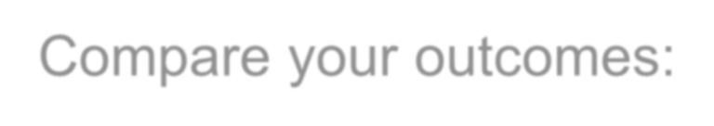

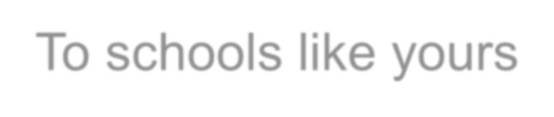








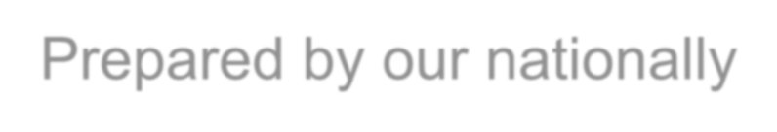

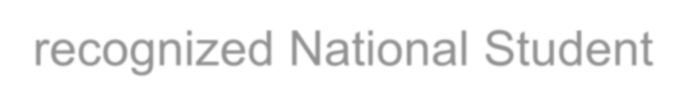
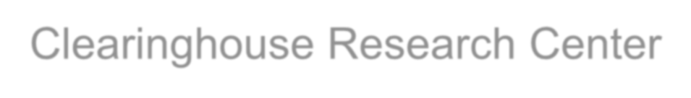
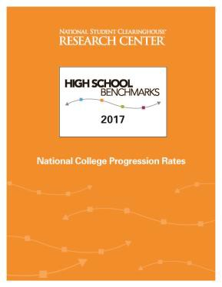
Compare Outcomes to
Your Peers
Compare your outcomes:
…To schools like yours
…Against National averages
Prepared by our nationally- recognized National Student Clearinghouse Research Center

Slide 31


Slide 40

Required Data Elements
First Name
Last Name
Date of Birth
Graduation Date
Diploma Type^
Graduation School*
ACT School Code*
FERPA Block Indicator^
^Data elements will be chosen from a given list
*Data elements provided on account reference sheet during implementation

Slide 41
Additional High School Data Elements
Gender^
Ethnicity^
Economically disadvantaged status^
Disability^
English learner or English as a Second Language indicator^
8th grade state assessment result – Math**
8th grade state assessment results – ELA/reading**
High school assessment result – Math**
High school assessment result – ELA/reading**
Number of Semesters of math completed
Dual enrollment indicator^
Program Code – open field can be used for internal tracking
^ Data elements will be chosen from a given list
**Choose from Does Not Meet/Meets/Exceeds Standards

Slide 43


Slide 44


Program Code Field
Female Asian Hispanic
Free/Reduced
Some College First Generation Advanced Diploma SAT Prep
College/Career Prep
IB Program AP Course
AP Physics Score
SAT Score
F2113150011PA31440
Program Code is an open field that can be used for internal tracking. This is a 50 character field that high schools, districts, counties, or state programs use to insert their own additional data. Examples of what schools use this field for parent education level, test scores, expanded definitions of Asian or Hispanic, qualified for free or reduced lunches, HS counselor name, and so much more. *Do not use commas or semicolons to separate indicators.

Slide 45
What programs do you have on your campus that can support your college going rate?
AVID
CTE Pathways
Legacy Programs
AP Teachers
JROTC
Athletics
English Learner Coordinator
SPED Coordinator
Clubs

Slide 46
Strategies Used to Ensure Students Enroll and Persist
College Kickoff and College Signing Day
College Now summer programs for recent graduates and eleventh grade students
Race to Submit FAFSA/CA Dream Act application submission and completion efforts
Ensuring every four year university eligible student applies to three or more colleges
Student Tracker empathy interviews
School counselor college and career professional development
Race to Rigor initiative to ensure enrollment in rigorous coursework
Race to Ready partnership with local higher education institutions

Slide 47
NSC Online Resources
NSC StudentTracker
StudentTracker for High School: FAQs, example files, detail report guide, and so much more
Clearinghouse Academy: Tutorials, webinars, and live events
NSC Research Center
High School Benchmarking Research report
Information on FERPA Blocks Information on what a FERPA Blocks, how it
affects the data, list of schools with over 10% rates, and

Slide 48
Other Resources
Federal Resources
College Navigator: Includes college federal designation of school type (2- year, 4 year), graduation rates, average financial aid, and more. Most recent data is 2 years old.
Common Core Data: Database on public elementary and secondary education in the United States. Most recent data is 2 years old.
Bureau of Labor Statistics Occupational Outlook Handbook: Career information on duties, education and training, pay, and outlook for hundreds of occupations.
23
© 2019 National Student Clearinghouse. All Rights Reserved.

Slide 49

FOR MORE INFORMATION ON OUR
INITIATIVES PLEASE VISIT US @
www.rcec.us

